Slide 1

CAPSTONE SPRINT 3
Aaron Tu

Slide 2
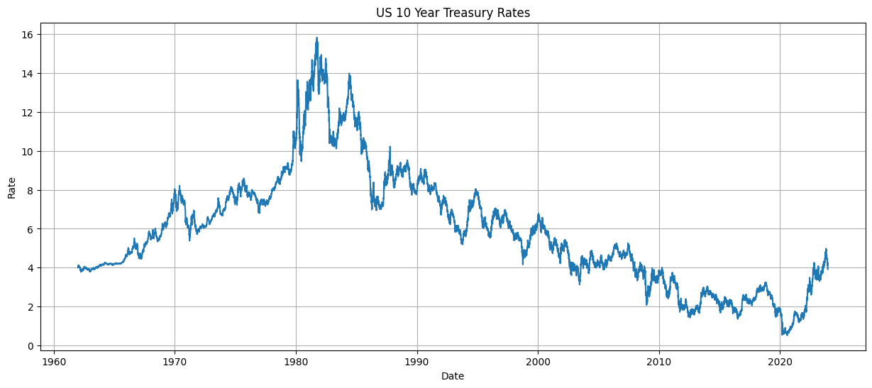
Project Overview
Tracking systemic liquidity: flow of capital and credit within the global financial system
Attempt to understand the cyclical nature of liquidity within the US financial system
Forecast future interest rates via 10 year US Treasury bonds and related assets
Strategically leveraging the current condition in your own business.
Apply Machine Learning Techniques
ARIMA
CNN

Slide 3
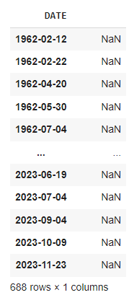
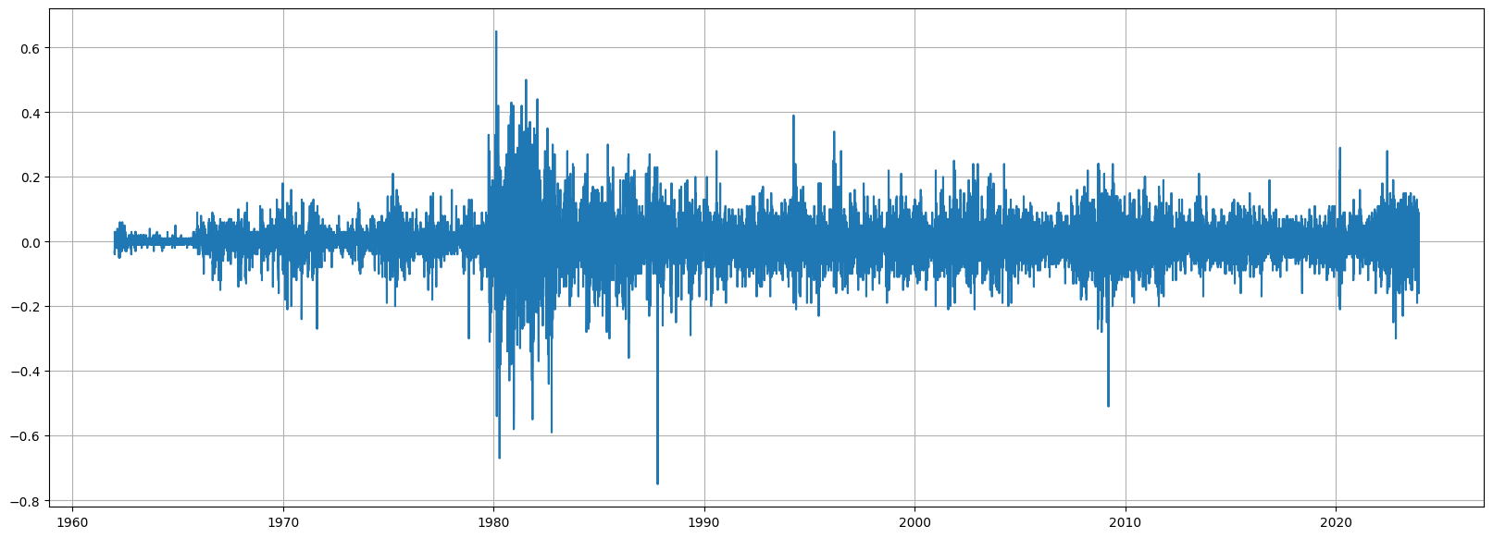
Time-series Data Pre-processing
Converting non-stationary data to stationary
Data cleaning

Slide 4
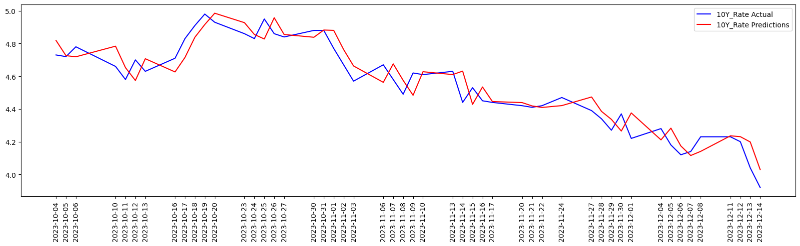
BASE MODEL ARIMA
Root Mean Squared Error 0.08549
US 10 Year Rates

Slide 5
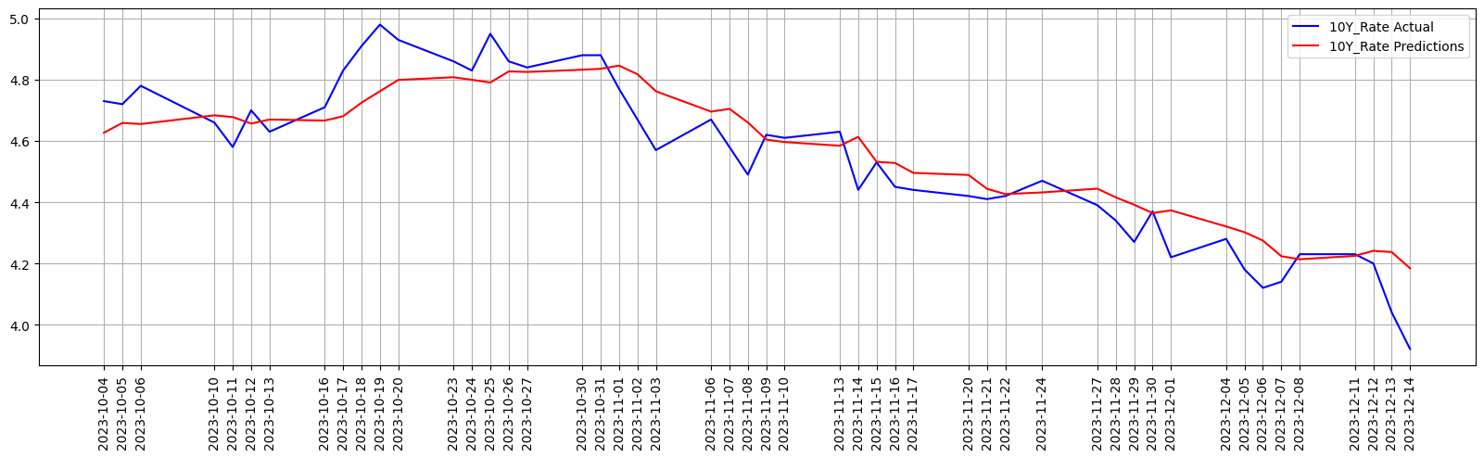
Advanced Modeling Convolutional Neural Network
Univariate forecasting
Short-term predictions
Root Mean Squared Error 0.10627

Slide 6
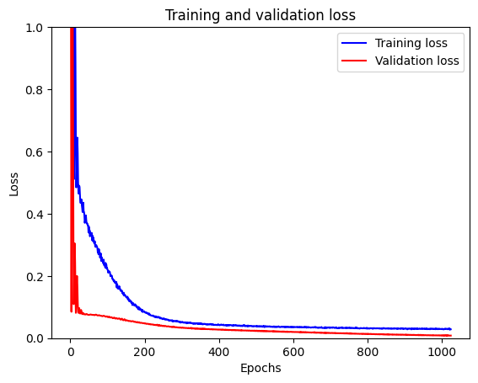
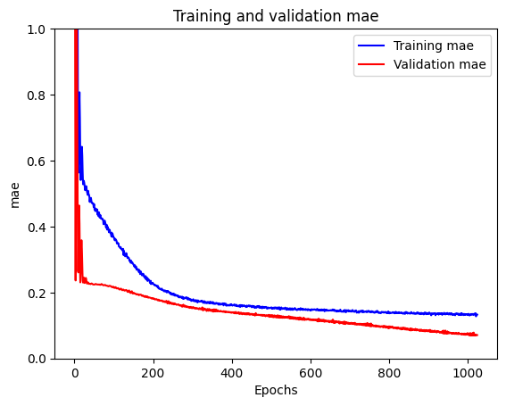
CNN Training and validation

Slide 7
Conclusion
ARIMA performed better than CNN 0.08549 vs 0.10627
Linear regression vs deep learning of sequenced data
Constant vs Random
Other techniques
Feature engineering

